Slide 1
EIT x Soft Robots: project update
Week of Monday 21/06/2021

Slide 2
Things to do/I’m doing
Add stepper motor to get set/predictable actuation
Do multiple iterations of actuator tests to gather more data
Refine actuator design (new moulds, iterate on actuator until a satisfactory design)
Investigate ML solutions for control problem (possibly just with voltages, may need full EIT images)

Slide 3
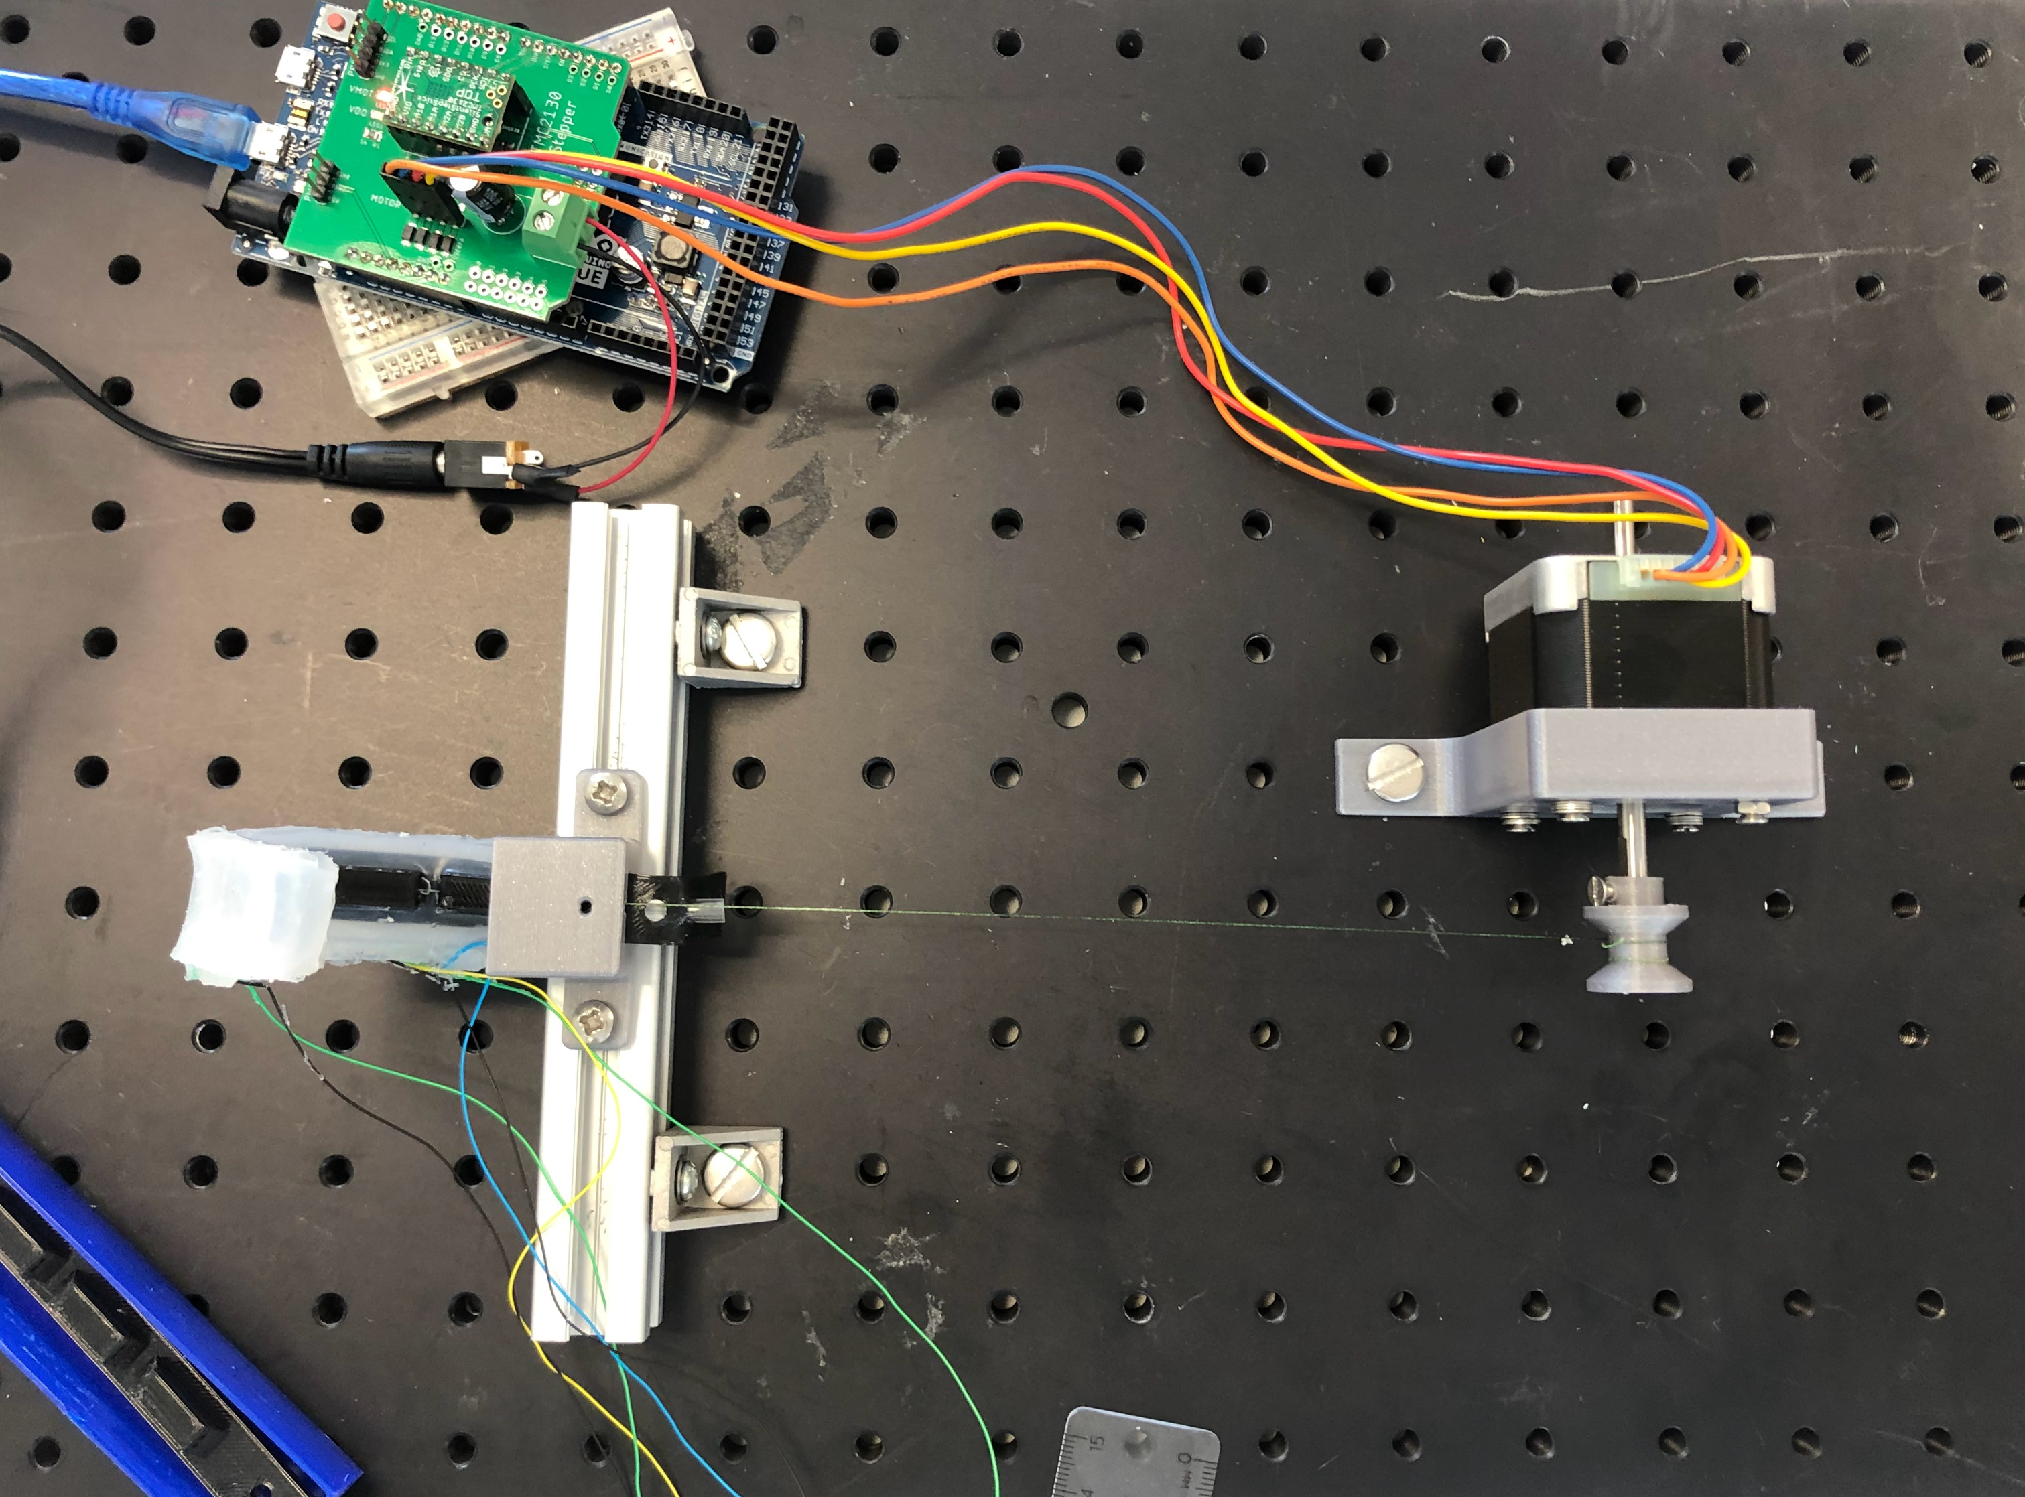
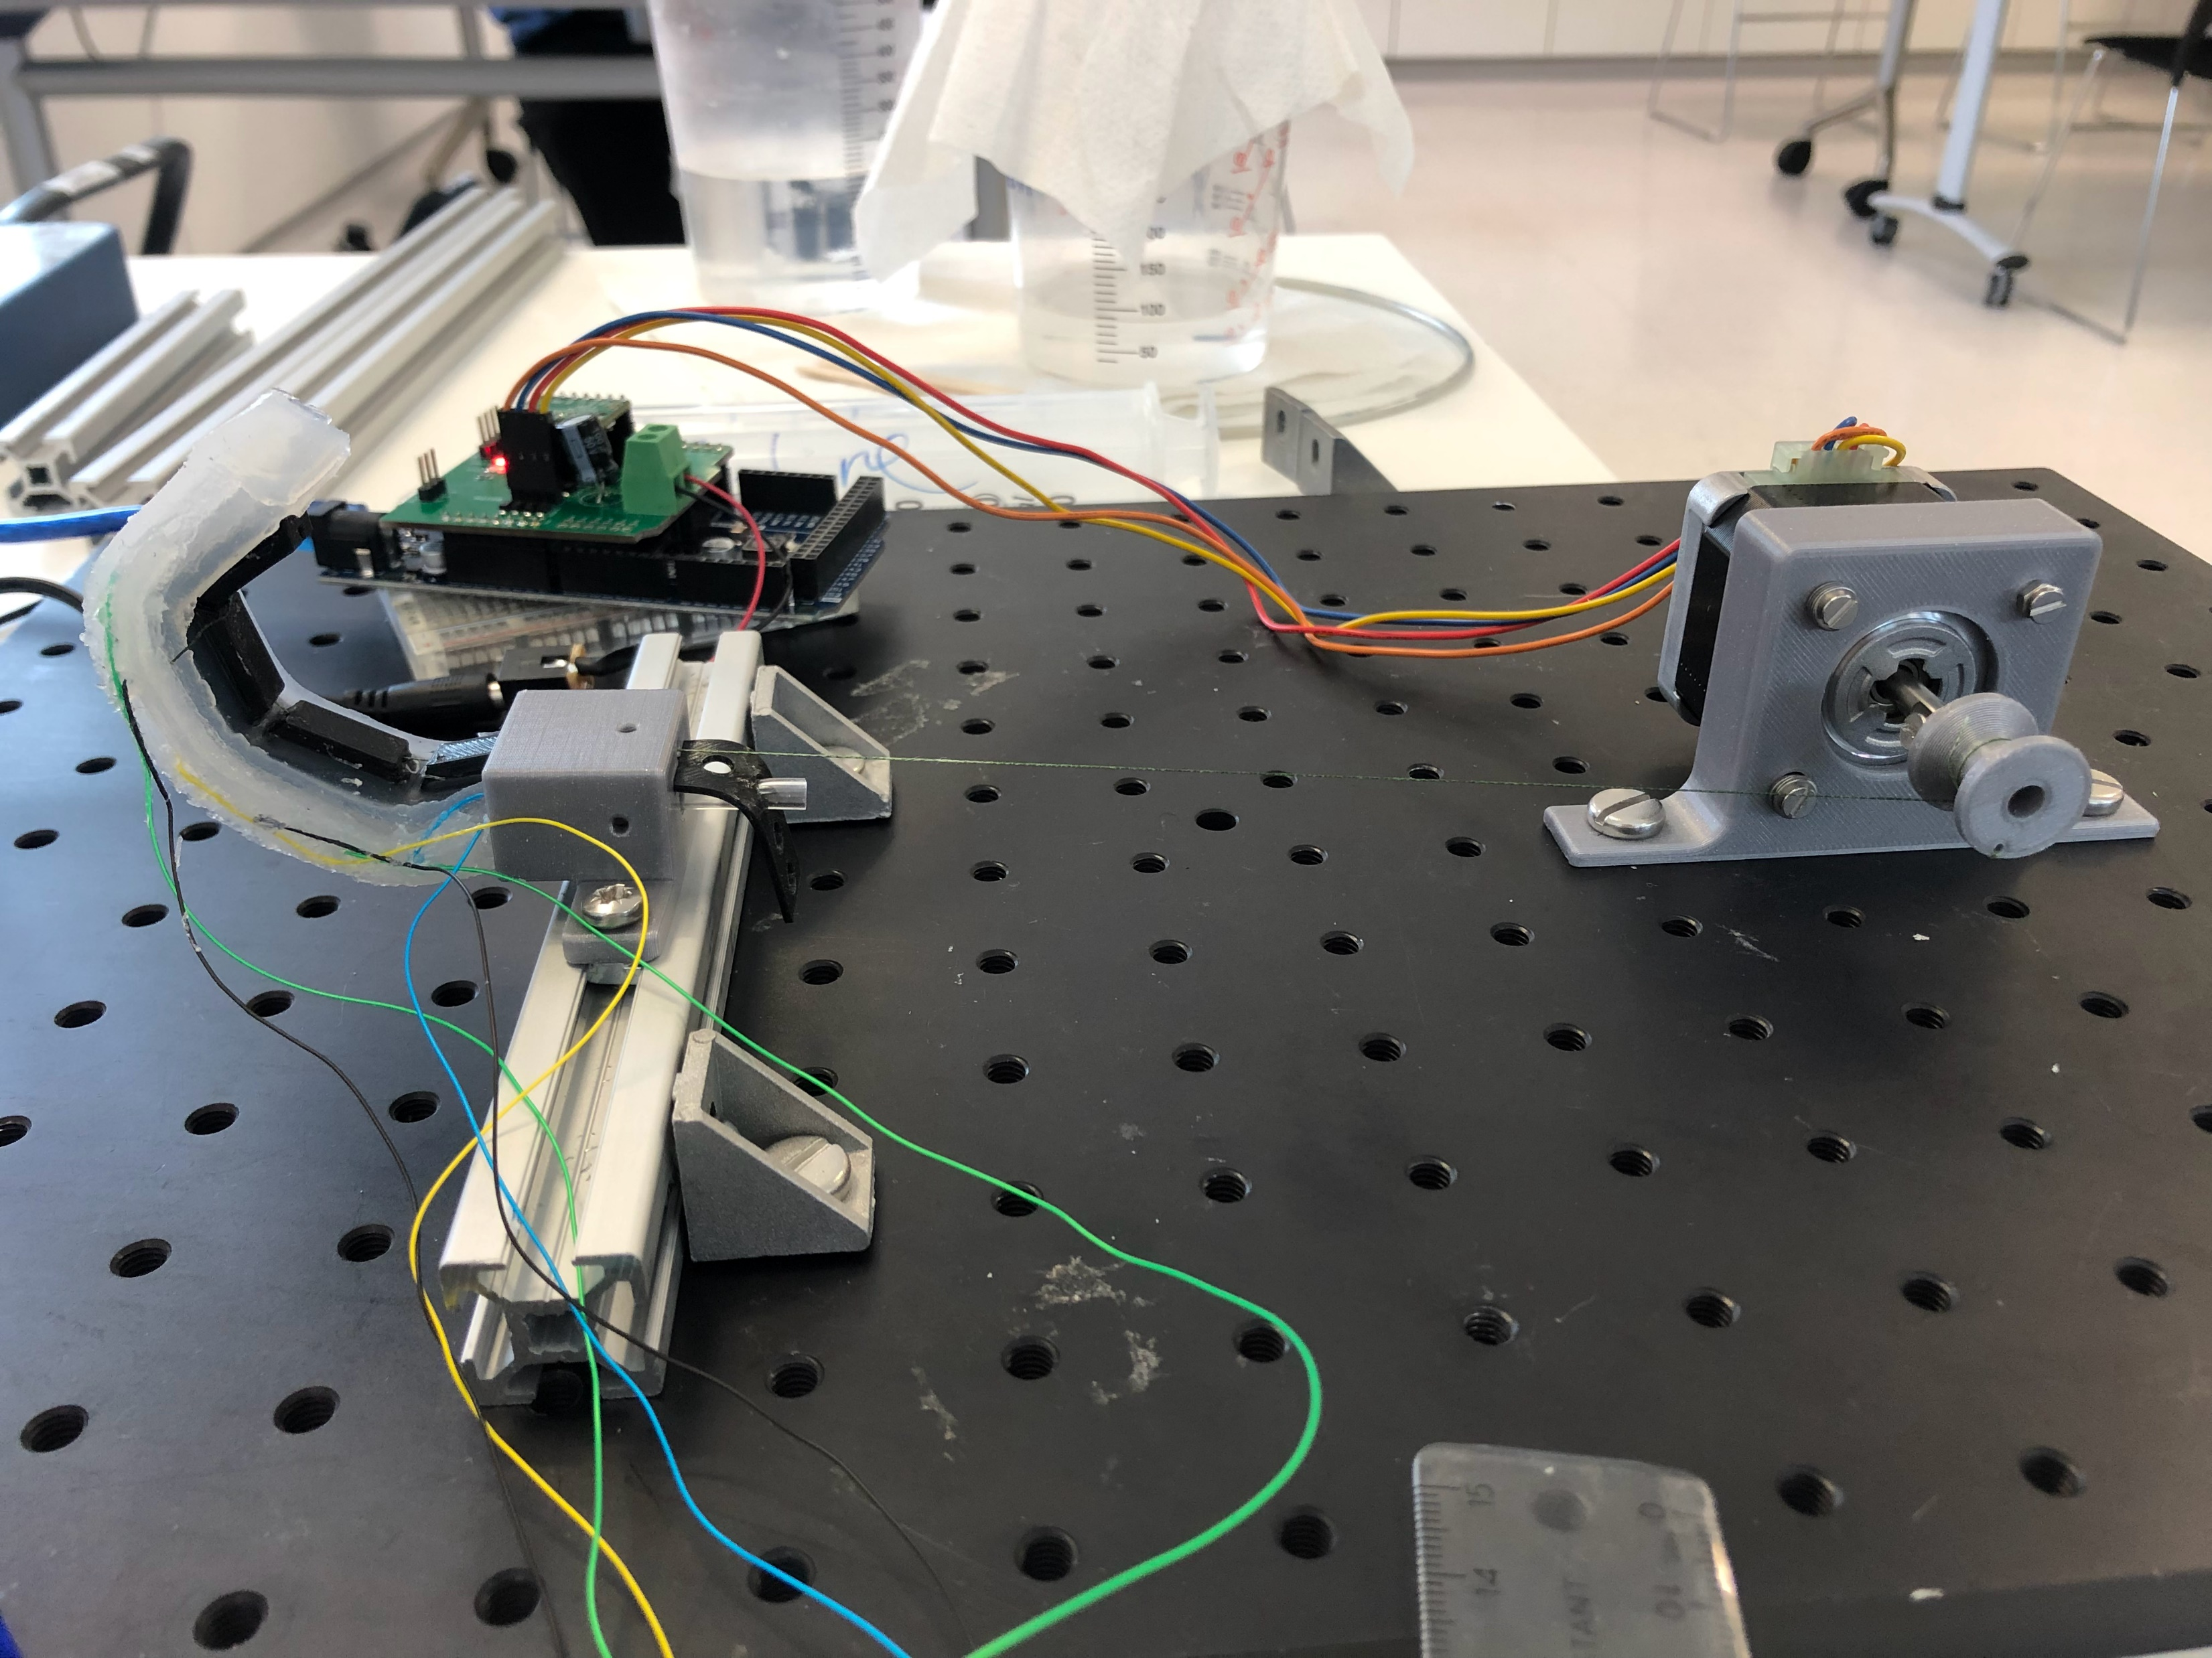
SDM actuator with cable setup

Slide 4
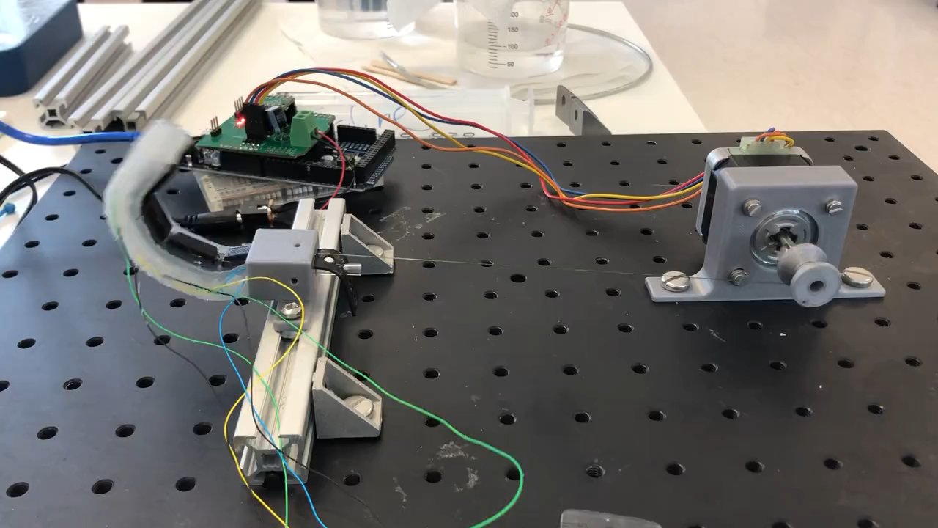
SDM actuator with cable setup

Slide 5
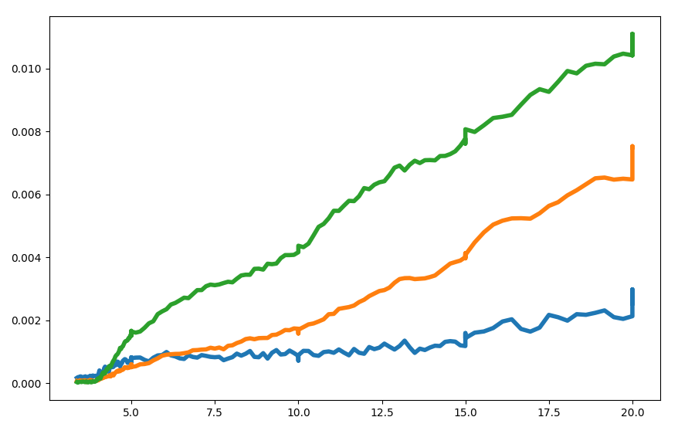
Manufactured distance data with voltage change
Change in voltage (mV)
Cable pull distance (mm)

